Slide 1
Welcome and introduction to the School
summer@fis.agh.edu.pl
Agnieszka Obłąkowska-Mucha
AGH UST Kraków
amucha@agh.edu.pl

Slide 2
Computer Science Detectors
MENU
Supervisors
Group of scientists:
we are passionate about physics OR computer science OR detectors OR electronics,
we work at AGH UST Kraków, Faculty of Physics and Applied Computer Science,
we are members of either of ATLAS or LHCb Collaborations,
we are seniors, juniors or PhD Students,
we teach physics, particle physics, computing (C++, Python), Machine Learning, Statistics, Data Analysis, VR, electronics, etc…
Physics

Slide 3
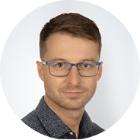
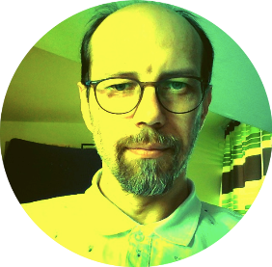
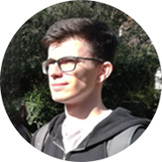
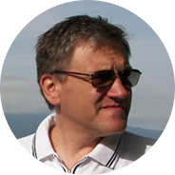
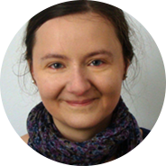
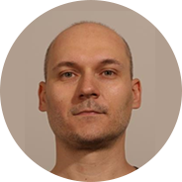
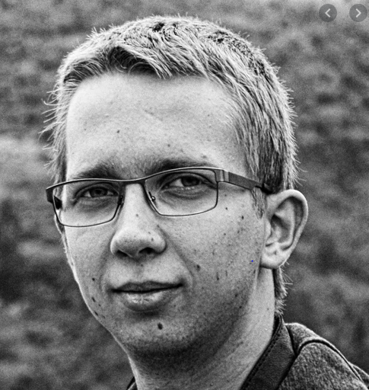
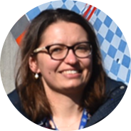
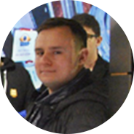
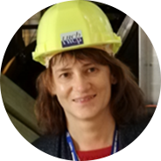
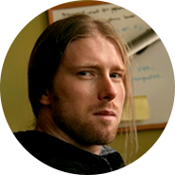
Computer Science Detectors
MENU
Supervisors
Bartek Rachwał Tomasz Bołd Paweł Kopciewicz Andrzej Skoczeń
Iwona Grabowska-Bołd Tomasz Szumlak Bartosz Mindur Paweł Jurgielewicz
Klaudia Maj Wojtek Krupa Agnieszka Maciek Kopeć Obłąkowska-Mucha
School Coordinator
Piotr Kotko
Physics

Slide 4
Computer Science Detectors
MENU
Students
35 students applied for the 2020 (first) edition of School:
Indonesia
Pakistan
Lodz University of Technology
Poznan University of Technology
Wroclaw University of Science And Technology
University of Silesia
AGH UST Kraków:
Faculty of Electrical Engineering, Automatics, Computer Science and Biomedical Engineering
Faculty of Metals Engineering and Industrial Computer Science
Faculty of Physics and Applied Computer Science
Physics

Slide 5
MENU
Projects
We prepared about 20 projects and matched them with students.
Not all students were accepted.
Supervisors will contact students today.
The main platform for communication is MS Teams.
Team „Applied Physics and Computer Summer School’20” is open for school supervisors and participants.
Each team has a dedicated private Channel and Chat.
Each team has its own work environment (see today after lunch).
Materials on Indico (agenda) are public .
Problems? Write to supervisor or to summer@fis.agh.edu.pl

Slide 6
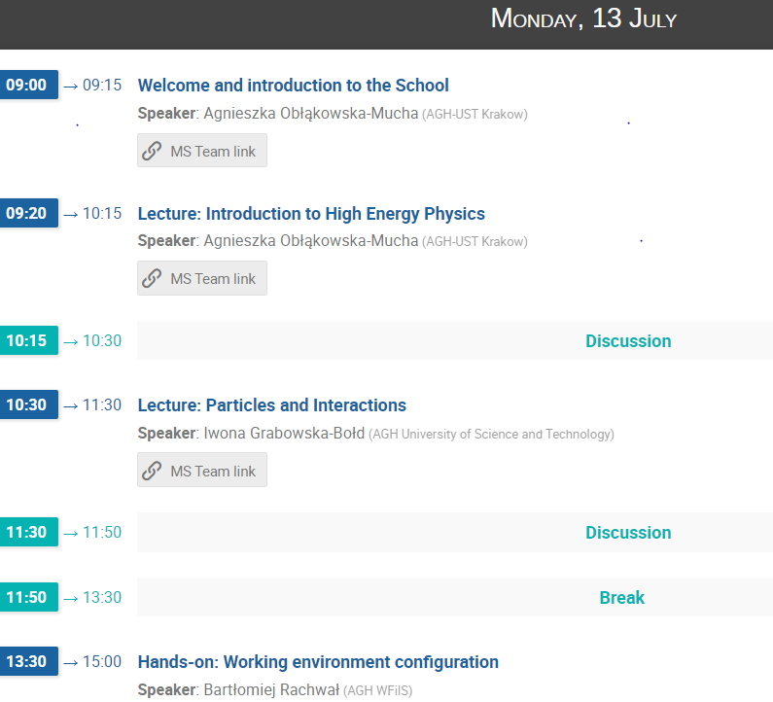
MENU
Lectures
WHY ?
How To Start ?

Slide 7
MENU
Lectures
WHERE ?

Slide 8
MENU
Lectures
HOW ?

Slide 9
MENU
Lectures
More HOWs

Slide 10
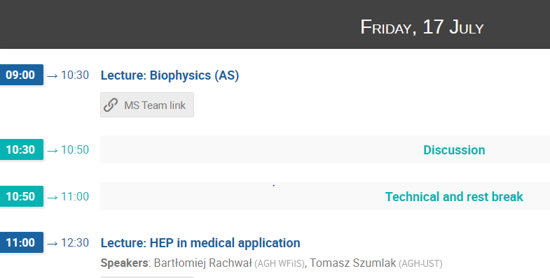
MENU
Lectures
EXTRAS

Slide 11
MENU
NVIDIA Course
We will meet between 7-18 of September again to complete the 4-week training.
As a special event a course of NVIDIA will be organised.
You can still apply – wite an email to summer@fis.agh.edu.pl
Tomek – could you elaborate ?

Slide 12
MENU
Seminar Session
We believe that in September live sessions will be possible and a real seminar can be organised.
Otherwise the School stays online.

Slide 13
MENU
AGH-praktyka
Uczestnictwo w szkole może być zaliczone jako praktyka zawodowa, jeżeli uzyskane zostaną odpowiednie efekty kształcenia:
praca zespołowa,
poznanie przyszłych pracodawców,
poznanie narzędzi pracy,
nauka prezentacji wyników pracy.
Studenci powinni napisać 2-stronicowe sprawozdanie z uwzględnieniem tych punktów i uzyskać potwierdzenie u opiekunów (15.09.2020).
Jesteśmy w stanie dopasować potwierdzenia uczestnictwa również do innych wymagań.

Slide 14
Thank you for your attention!
Now a few lectures …
… enjoy and let’s start working!

