Slide 1
Kraków Applied Physics and Computer Science
Summer School’20
13th of July 2020
Introduction to High Energy Physics
Agnieszka Obłąkowska-Mucha
AGH UST Kraków

Slide 2
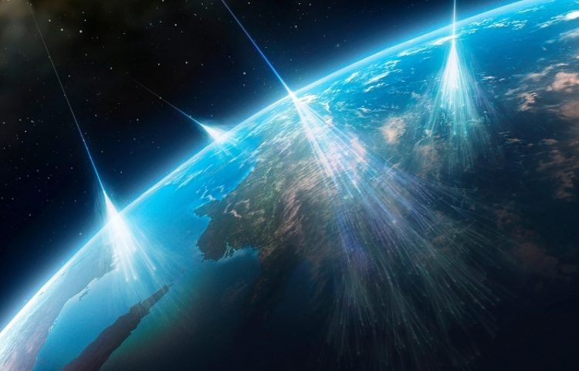
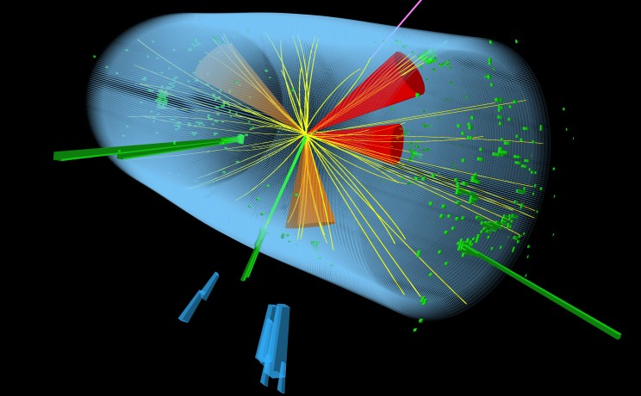
High Energy Physics deals with particles
Where can we search for particlcels?
Matter
Cosmos
Physics experiment
Smog, beer, mobile Cosmic radiation Large Hadron Collider
The same constitutions are present in all these situations
A.Obłąkowska-Mucha AGH UST Kraków

Slide 3
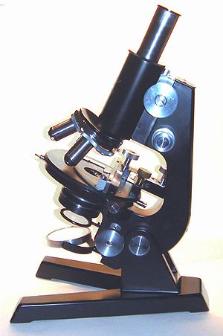
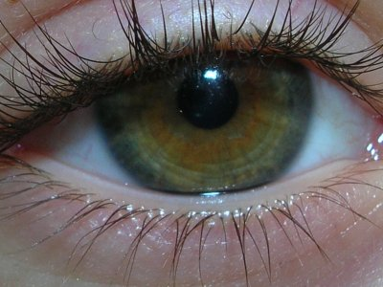
Matter
Our matter consist of atoms which contains electron and nucleus, nucleus has structure build of quarks and gluons
How can you believe in this? Because you can see it?
?
No, you know this because you can make an experiment to prove it
A.Obłąkowska-Mucha AGH UST Kraków

Slide 4
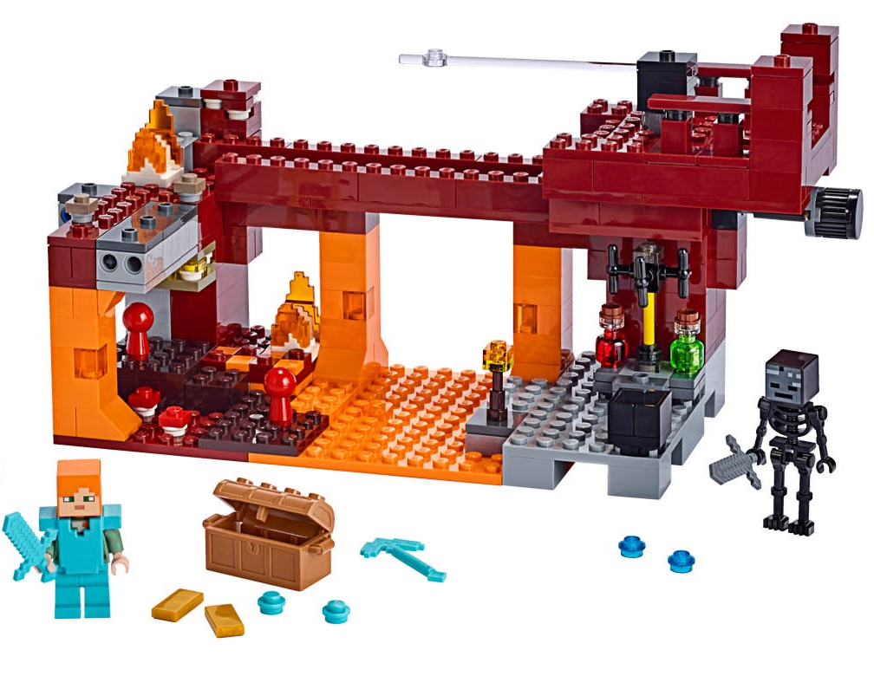
Matter = atoms + interactions
Matter
Particles are either:
FUNDAMENTAL
(they have no internal strucure)
or
COMPOSITE
(they are composed of some combination of the fundamental particles)
Atoms, nuclei, protons, and neutrons are
COMPOSITE
Electron, neutrino and quarks are
FUNDAMENTAL
A.Obłąkowska-Mucha AGH UST Kraków

Slide 5
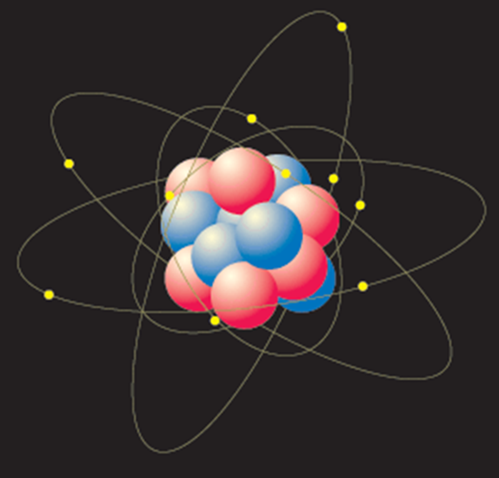
Atom = nucleons + electrons
Atom
Particles are either:
FUNDAMENTAL
(they have no internal strucure)
or
COMPOSITE
(they are composed of some combination of the fundamental particles)
Atoms, nuclei, protons, and neutrons are
COMPOSITE
Electron, neutrino and quarks are
FUNDAMENTAL
A.Obłąkowska-Mucha AGH UST Kraków

Slide 6
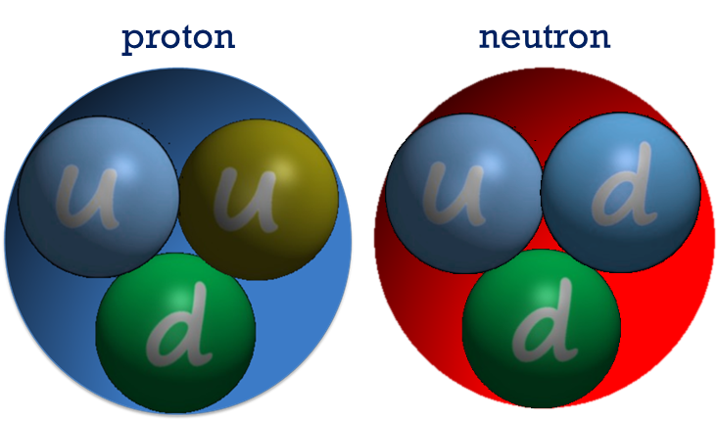
Nucleon = proton or neutron
Particles are either:
FUNDAMENTAL
(they have no internal strucure)
or
COMPOSITE
(they are composed of some combination of the fundamental particles)
Protons and neutrons are
COMPOSITE
Electron, neutrino and quarks are
FUNDAMENTAL
A.Obłąkowska-Mucha AGH UST Kraków

Slide 7
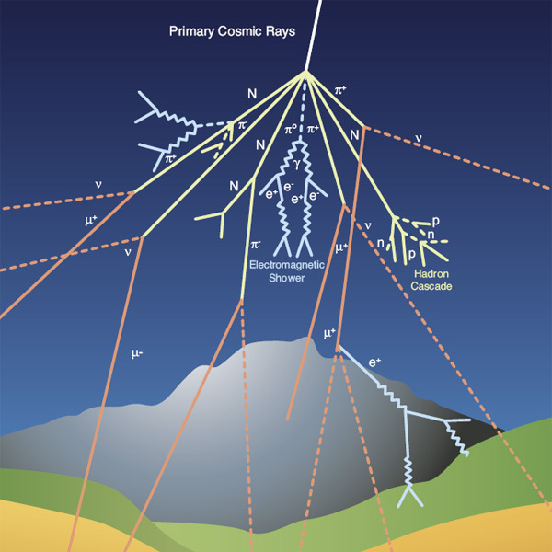
Cosmic radiation = protons + muons + strange particles
Wait long enough and you can see it in cosmic rays…
… and even find some strange particles
They are produced when protons enter the Earth’s atmosphere and collide with gases
A.Obłąkowska-Mucha AGH UST Kraków

Slide 8
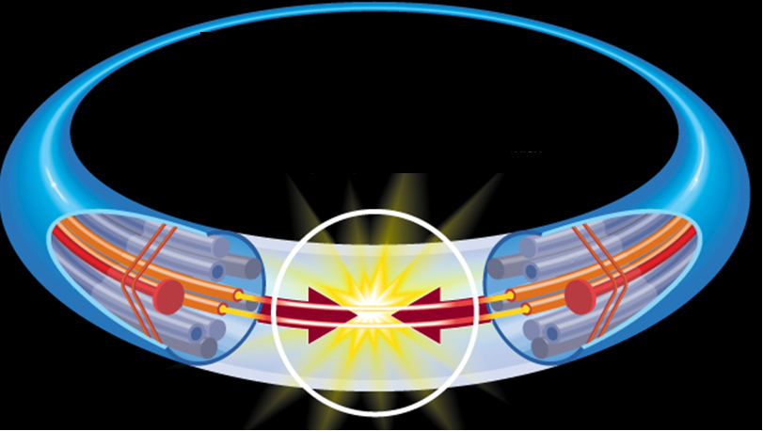
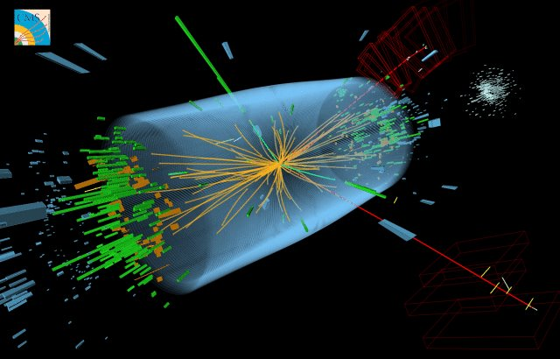
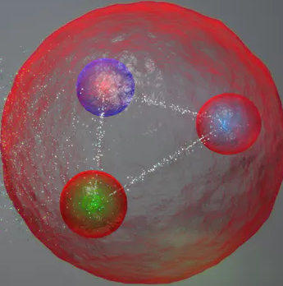
Physics experiments = accelerator + detectors
Instead of waiting for a cosmic event we can make such collisons in laboratory, like CERN.
Large Hadron Collider (LHC)
protons
protons
14 TeV
7 TeV
7 TeV
The maximum achievable energy is limited by the technical capabilities only (and time & money).
A.Obłąkowska-Mucha AGH UST Kraków

Slide 9
Particles = leptons + quarks + bosons
The reason for breaking the energy limit is because more interesting particles are heavier and heavier.
Energy = mass?
Well, almost:
$$E_{e} = \left(9.1×{10}^{−31} kg\right)×\left(3×{10}^{8}\frac{m}{s}\right)2 = 8.2×{10}^{−14} J$$
$$≈ 510 000 eV =510 keV$$
A.Obłąkowska-Mucha AGH UST Kraków

Slide 10
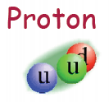
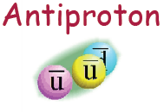
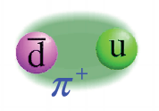
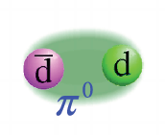
Problem: quarks cannot exist as free particles
Quarks are always confined in composite particles called hadrons.
The only stable particle is proton, heavier particles decay to lighter states.
In an experiment, we can catch only stable particles (proton, electron, muon) or particles which lifetime is long enough to interact with active material of detectors (pions, kaons, and a few more).
Other particles can be reconstructed from the final decay products.
A.Obłąkowska-Mucha AGH UST Kraków

Slide 11
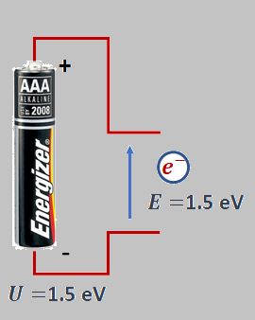
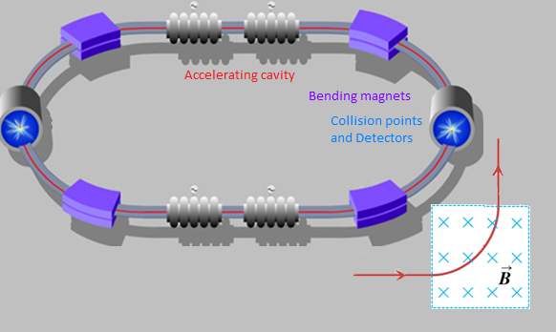
Accelerator (Large Hadron Collider)
But we need more batteries to build LHC, therefore it is more economical to re-use the same accelerating devices many (10⁸) times.
But to make protons move in stable orbit, one needs huge magnetic field.
Charged particle (protons, elektrons, ions) can be accelerated in electric field.
$${\vec{F}}_{e}=m\vec{a}$$
$${\vec{F}}_{e}=q\vec{E}$$
$${\vec{F}}_{L}=q\vec{v}×\vec{B}$$
A.Obłąkowska-Mucha AGH UST Kraków

Slide 12
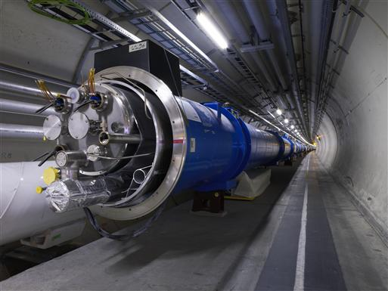
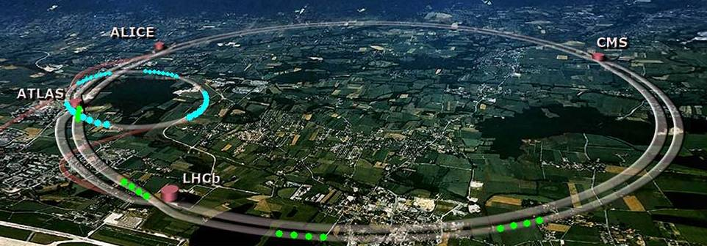
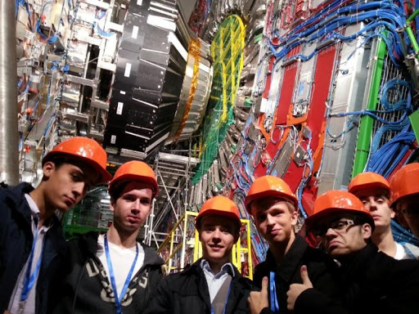
CERN = people + accelerator + detectors
LHC
magnet
A.Obłąkowska-Mucha AGH UST Kraków

Slide 13
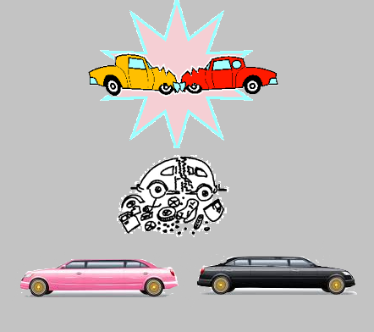
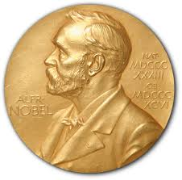
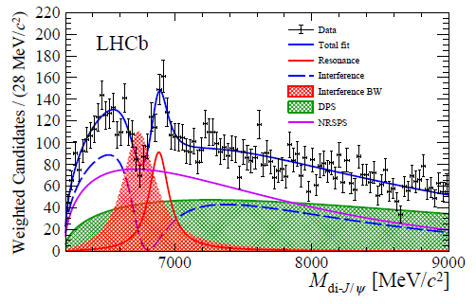
Collisions – a few facts and figures
The energy of a collision (centre-of-mass-energy $\sqrt{s}$) is transferred to the production of new particles.
Theory predicts what might happen during a collision at given energy and with what probability.
We call it a cross-section for a production of a state (like beauty quarks or Higgs boson) at centre-of-mass-energy σ(√s).
A lot of distributions, parameters have to be determined from experiment and compared with theory to win a Nobel prize.
In most often situations physics makes tricks and is hidden beneath the prevalent uninteresting events (background).
And then comes the Computer Science and Machine Learning.
A.Obłąkowska-Mucha AGH UST Kraków

Slide 14
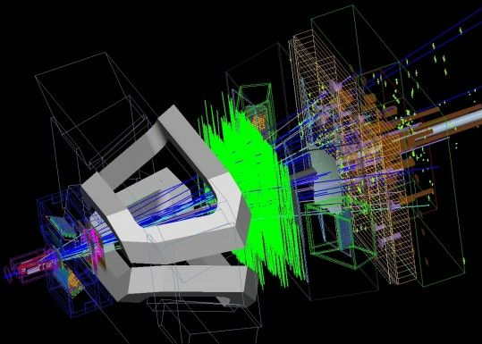
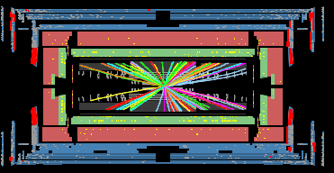
Where are quarks?
Stable or long-lived particles interact with the material of detectors.
As a result an electric signal or flash of light is produced and sent to the readout electronic.
Signals from many stations, layers, sensors must be connected to form a track (track reconstruction).
If the reconstruction is correct then we can attribute this track to a given type of particle.
Particle has mass, charge, spin, time of decay, angular distribution – this information helps to establish what type of quarks or leptons were produced and what kind of interaction occurred among them.
A.Obłąkowska-Mucha AGH UST Kraków

Slide 15
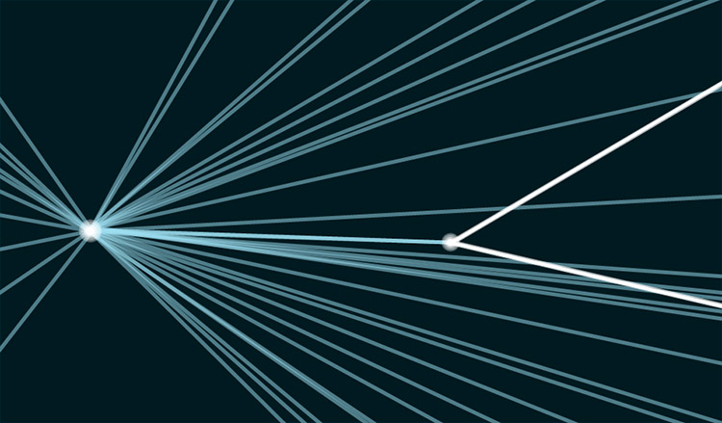
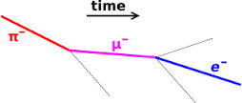
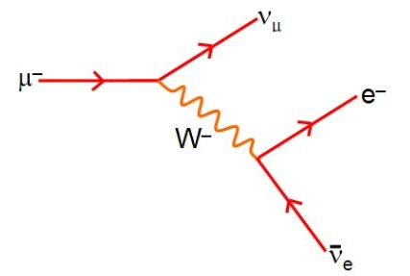
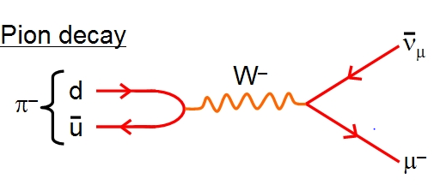
Where are quarks?
Stable or long-lived particles interact with the material of detectors.
As a result an electric signal or flash of light is produced and sent to the readout electronic.
Signals from many stations, layers, sensors must be connected to form a track (track reconstruction).
If the reconstruction is correct then we can attribute this track to a given type of particle.
Particle has mass, charge, spin, time of decay, angular distribution – this information helps to establish what type of quarks or leptons were produced and what kind of interaction occurred among them.
UC San Diego
140 MeV
106 MeV
0.5 MeV
A.Obłąkowska-Mucha AGH UST Kraków

Slide 16
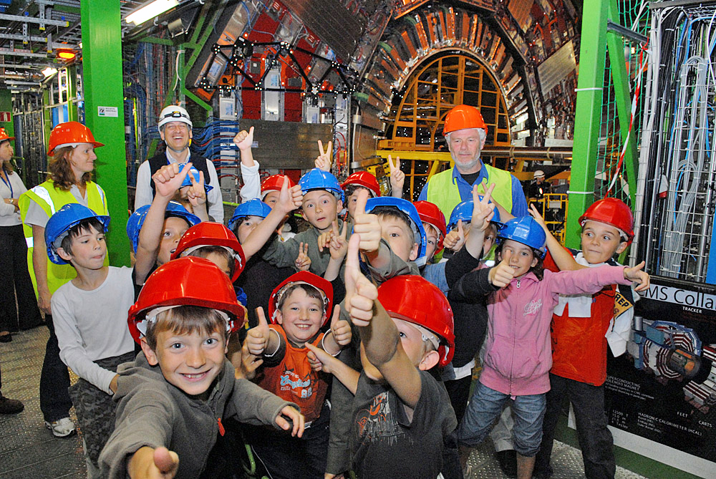
We need you….
High Energy Experiment requires huge human resources for many purposes and tasks:
Theory of physics for an idea of an experiment.
Bank loan.
Design of accelerators and detectors.
Production and assembly of the devices.
Electronics for signal formation and processing.
Computer scientists on each stage of design, reconstruction and analysis.
Physicist for data interpretation.
Guides for visitors.
Journalists for a nice story.
A.Obłąkowska-Mucha AGH UST Kraków

Slide 17
Thank you!
We will have plenty of time for a discussion but I suggest that we listen to the Iwona’s lecture about particles and interaction first…
A.Obłąkowska-Mucha AGH UST Kraków

