Slide 1



Odderon effects at LHC energies: extended Bialas–Bzdak model study
T. Csörgő^{1,2} and I. Szanyi ^{1,3}
¹ Wigner RCP, Budapest, Hungary
² MATE KRC, Gyöngyös, Hungary
³ Eötvös University, Budapest, Hungary
Statistically Significant Observations of Odderon
Model independent results:
Significance ≥ 6.26 σ
Model dependent results:
Significance ≥ 7.08 σ
D0-TOTEM results:
Significance ≥ 5.2 σ
New:
In the Bialas-Bzdak model
Odderon Significance » 10 σ
Valid in 0.541 ≤ s ≤ 8 TeV
and 0.377 ≤ -t ≤ 1.2 GeV²
First results on Odderon properties
Analysis of final 8 TeV data: I. Szanyi

Slide 2
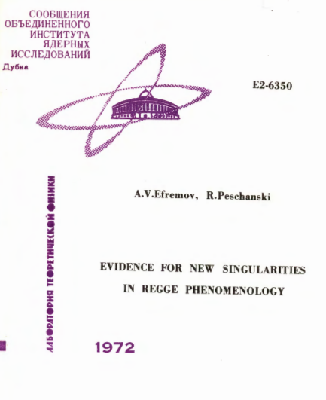
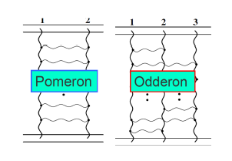
Odderon: 48 years old scientific puzzle
Odderon: L. Lukaszuk, B. Nicolescu,
Lett. Nuovo Cim. 8, 405 (1973)
Received: 31 July 1973
Odderon is an odd component of elastic scattering:
Changes sign for crossing
2
Odderon name coined: D. Joynson, E. Leader, B. Nicolescu, C. Lopez, Nuovo Cim. 30A, 345 (1975) - Well established in QCD by now !
Honorable mention: A. V. Efremov, R. Peschanski, JINR-E2-6350 (1972)

Slide 3
Essentially, Odderon
p+p → p+p
(RGB) + (RBG) → (BRG) + (BGR)
-
p+p → p+p
(RGB) + (RGB) → (GBR) + (GBR)
3
p₁
p₃
g₃
g₁
g₂
O = (g₁, g₂, g₃)
p₂
p₄

Slide 4
Odderon: elusive experimentally
Odderon search at ISR: indication but no conclusive result
Breakstone et al, Phys. Rev. Lett. 54, 2180 (1985): CL = 99.9 %
Indication of Odderon
CL = 99.9 %,
Significance: 3.35 σ
Terminology for this talk:
Agreement if statistical significance is < 3 σ
Indication of signal if 3 σ ≤ significance < 5 σ
Evidence or observation of signal if 5 σ ≤ significance
Discovery of signal if 5 σ ≤ significance for the first time.
4

Slide 5

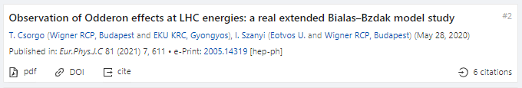
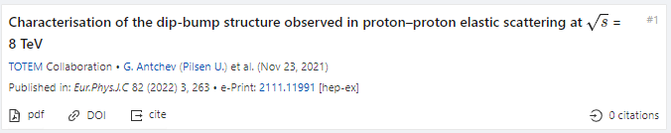
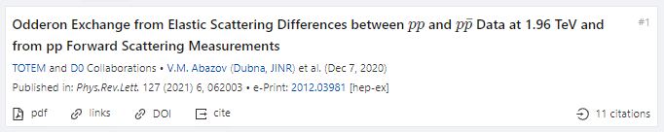
Observations of Odderon with > 5 σ
Eur. Phys. J. C (2021) 81: 180, Published: 23 February 2021
https://doi.org/10.1140/epjc/s10052-021-08867-6
Eur. Phys. J. C (2021) 81:611 , Published: 13 July 2021
https://doi.org/10.1140/epjc/s10052-021-09381-5
8 TeV: EPJ C (2022) 82, 263 (2022).Published: March 26, 2022
https://doi.org/10.1140/epjc/s10052-022-10065-x
5
Phys. Rev. Lett. 127 (2021) 6, 062003, Published: 4 August 2021
https://doi.org/10.1103/PhysRevLett.127.062003

Slide 6

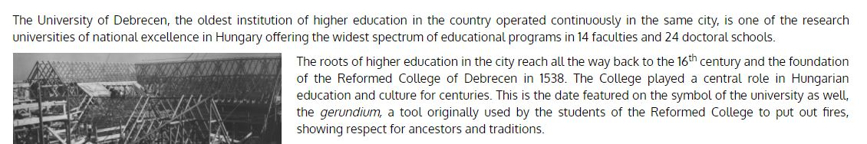
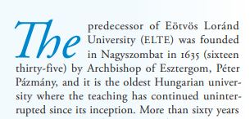
Three Oldest Hungarian Universities
University of Pécs: 1367
University of Debrecen: 1538
(S,C) structure evident,
S: statement, valid if
C: condition is satisfied
See talk of R. Dardashti at ISMD21
6
Eötvös Loránd University: 1635

Slide 7


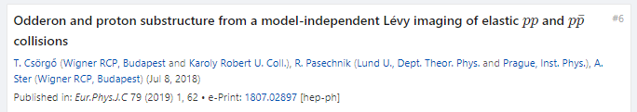
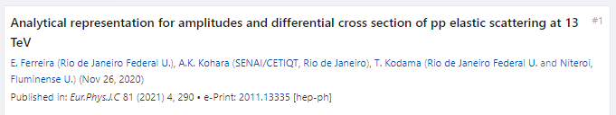
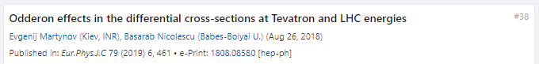
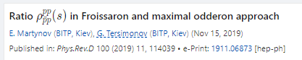
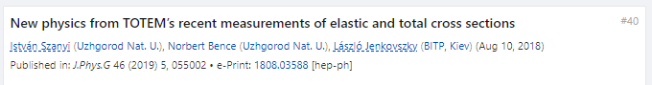
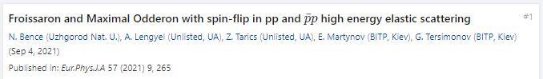
Honorable mentions: Odderon, qualitatively
Proposal for LHC to hunt down the Odderon:
Qualitative Odderon signals: in t-dependence of B(s,t) and ρ(s,t)
7

Slide 8
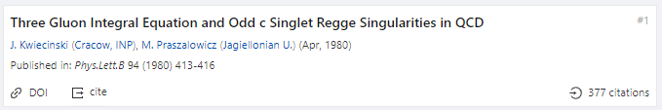

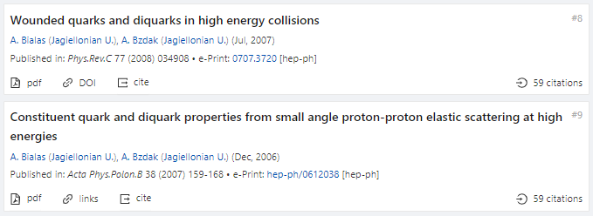
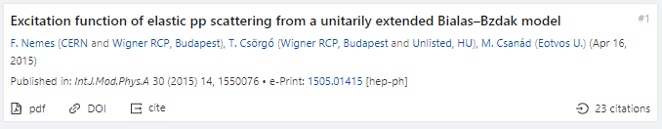
Odderon from Cracow
Incomplete list of important Odderon papers, in addition …
1980: KP QCD evolution equation for Odderon exchange
1999: A new Odderon intercept from QCD
2007-2008: Bialas-Bzdak model of elastic pp collisions
8
2015: Unitarily extended Bialas-Bzdak for dip. By-product: Odderon

Slide 9

Odderon: Real Extended Bialas-Bzdak (ReBB)
2021: Adding the real part to BB model in a unitarized way:
allows for a quantitative analysis of BOTH
elastic pp and pbarp data, in a limited kinematic (s,t) range
Using the unitarily real extended Bialas-Bzdak model
from 2015, without any change
New in 2022: TOTEM data at 8 TeV published, and analyzed in ReBB
9

Slide 10
Formalism: elastic scattering
10
Basic problem: dσ/dt measures an amplitude, modulus squared.
If Odderon exists: signals in elastic scattering at all t:
Both at t = 0 and at –t > 0 (!)

Slide 11
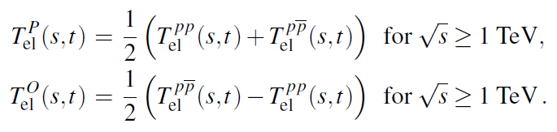






Strategy of Odderon Search
signals
at -t ≥ 0
valid for
3+3 = 6 simple consequences:
If
-t > 0
If
If
If
-t = 0
If
11
If

Slide 12

Model independent results since 2019
Eur. Phys. J. C (2021) 81: 180
https://doi.org/10.1140/epjc/s10052-021-08867-6
H(x) = 1/(B σ_{el}) dσ/dt vs x = - B t
B ≡ B₀(s) from now on
x = - B t = - B₀(s) t
12
S: Model independent Odderon significance ≥ 6.26 σ
C1: All D0 and TOTEM published data at 1.96, 2.76 and 7.0 TeV
C2: domain of validity is still determined model dependently.

Slide 13
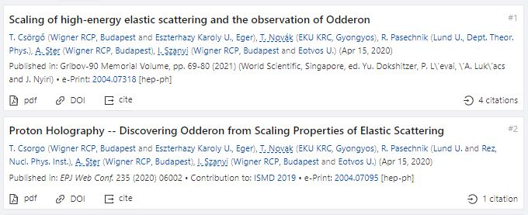
Model independent results (2)
Gribov’90 Memorial Volume, pp. 69-80 (2021)
https://doi.org/10.1142/9789811238406_0012
S: Model independent Odderon significance ≥ 6.26 σ
C1: All D0 and TOTEM published data at 1.96, 2.76 and 7.0 TeV
C2: domain of validity is still determined model dependently.
13
H(x,s₁)/H(x,s₂) nearly 1 for pp with small violations. Peak for pbarp over pp.
Small violations under theoretical controll (next slide).
Model independent Odderon significance 6.26 σ
Domain of validity: first, from ReBB model, by now: model independently

Slide 14
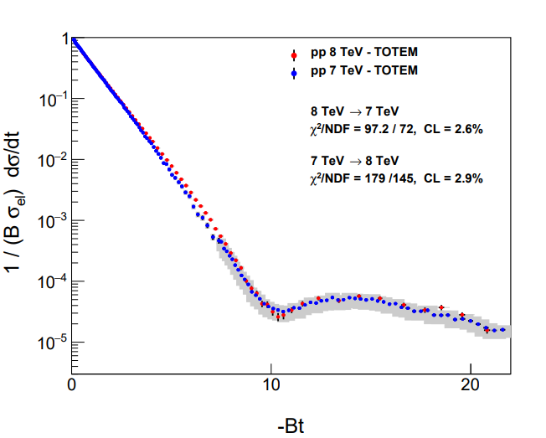
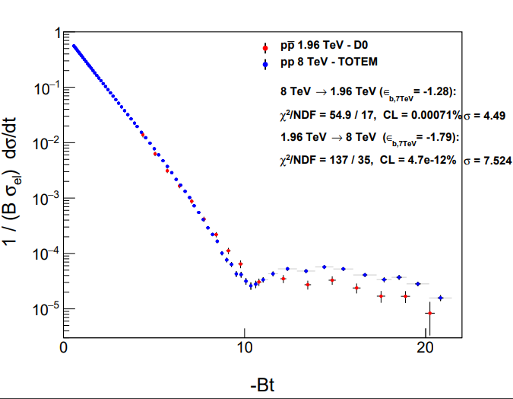
Model independent results (3): 8 TeV
New final H(x) result at 8 TeV
S: Model independent Odderon significance ≥ 6.26 ⊕ 4.17 = 7.4 σ
using Stouffer method: sig = (sig₁+sig₂)/sqrt(2)
C1: All D0 and TOTEM published data at 1.96, 2.76, 7.0 + new 8 TeV data (2022)
C2: Errors on 8 TeV are type A or type B (take conservative choice in each case)
H(x|s₁,pp) ≈ H(x|s₂,pp) with ≤ 2.11 σ for 7 and 8 TeV.
(0.189 σ for type A, 2.11 σ for type B errors on 8 TeV)
H(x|s₁,pp) ≠ H(x|s₂,pbar) with ≥ 4.17 σ for 1.96 and 8 TeV.
(4.17 σ for type A, 4.49 σ for type B errors on 8 TeV)
Based on new TOTEM 8 TeV data, e-Print: 2111.11991 [hep-ex], EPJC (2022) 82:263
14

Slide 15
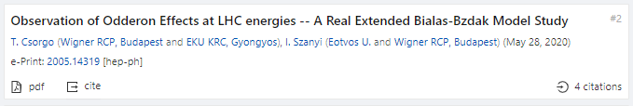
Model dependent evidence for Odderon
Eur. Phys. J. C (2021) 81:611, detailed by I. Szanyi
https://doi.org/10.1140/epjc/s10052-021-09381-5
1.96 TeV
2.76 TeV
7 TeV
S: Model dependent Odderon significance ≥ 7.08 σ
C1: All D0 and TOTEM published data at 1.96, 2.76, and 7.0 TeV
C2: domain of validity extended to both pp and pbarp
But limited to 0.37 ≤ −t ≤ 1.2 GeV² and 0.546 ≤ sqrt(s) ≤ 8 TeV
15
Model dependent, Real Extended Bialas-Bzdak theory results,
Odderon significance ≥ 7.08 σ, from 1.96 and 2.76 TeV data only

Slide 16
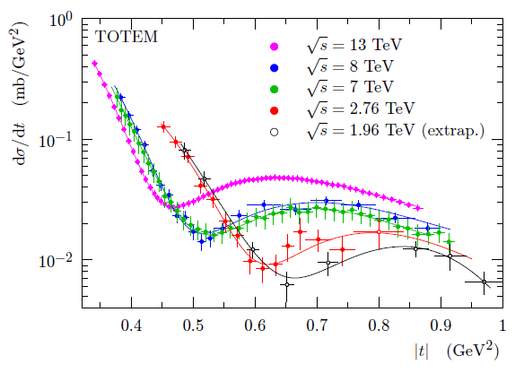
Evidence for Odderon, new D0-TOTEM
Phys. Rev. Lett. 127 (2021) 6, 062003, Published: 4 August 2021
https://doi.org/10.1103/PhysRevLett.127.062003
C0: if earlier models used for significance analysis at t=0 form a representative sample of models
S: Odderon significance ≥ 5.2 σ, IF
C1: if almost model independently combined
with √s = 13 TeV data at t = 0: σ_{tot} and ρ₀
C2: using a new pp dataset at 8 TeV and a new data point at 2.76 TeV,
C3: if only 8 out of the 17 D0 points are used
C4: if D0 pbarp data and TOTEM pp extrap.data are assumed to be equal at t=0
C5: ρ₀ (1.96 TeV) = 0.145
16

Slide 17

Evidence for Odderon, D0-TOTEM
Phys. Rev. Lett. 127 (2021) 6, 062003, Published: 4 August 2021
https://doi.org/10.1103/PhysRevLett.127.062003
TOTEM: sig₁ (13 TeV, t = 0) ≥ 4.2 σ
TOTEM: combined (sig₁ + sig₂)/√2 ≥ 5.2 σ
Donnachie-Landshoff preprint: sig₁ (13 TeV, t = 0) = 0 (?!)
sig₂ ≥ 3.4 σ
17
C0: if almost model independent result at t=0 and √s = 13 TeV
AND if sig₁ is not modified by new models: sig₁ ≥ 4.2 σ

Slide 18
POMERON PROPERTIES
MODEL RESULT BASED ON EPJC 81 (2021) 7, 611
1st property, preliminary:
Pomeron intercept normal: α_{P}(0)-1 = 0.075 ± 0.001

Slide 19
ODDERON PROPERTIES
MODEL RESULT BASED ON EPJC 81 (2021) 7, 611
1st property, preliminary:
Odderon intercept is large, α_{O}(0)-1 = 0.32 ^{+ 0.32} _{– 0.06}
Pomeron intercept normal: α_{P}(0)-1 = 0.075 ± 0.001
2nd property:
1.96 TeV ~ threshold energy

Slide 20
ODDERON dσ/dt and Phase(s,t)
ReBB MODEL RESULT FROM EPJC 81 (2021) 7, 611

Slide 21
Im OF ODDERON AMPLITUDE
BASED ON ReBB MODEL OF EPJC 81 (2021) 7, 611
1st property:
Zeros of Odderon amplitude
Im T_{O}(s,t) has two zeros: ~ unexpected
2nd property: fixed points (one final, one preliminary)
Im T_{O}(s,t) has two fixed points: expected ??

Slide 22
Re OF ODDERON AMPLITUDE
BASED ON ReBB MODEL OF EPJC 81 (2021) 7, 611
3rd property:
Zeros of Odderon amplitude
Re T_{O}(s,t) has two zeros: expected
4th property: fixed points (one final, one preliminary)
Re T_{O}(s,t) has two fixed points: expected ??

Slide 23
Summary: Odderon DISCOVERED in 3 papers,
New: focus on its properties
Bialas-Bzdak p = (q,d) model: certain Odderon effect
statistical significance » 5 σ
Odderon first discovered in three published papers:
three different analysis, each with a statistical significance > 5 σ
(S,C) structure evident,
Scientific Statement S is valid if Condition C is satisfied
0th property: Odderon exists! (Questioned: where, at 13 TeV and t=0?)
Odderon properties: from Bialas-Bzdak model, so far valid in a limited s and –t > 0.37 GeV² range only
Odderon intercept is large, α_{O}(0)-1 = 0.32 ^{+ 0.32} _{– 0.06}
Pomeron intercept normal: α_{P}(0)-1 = 0.075 ± 0.001
1.96 TeV – 8 TeV:
Threshold effect, just appearing
Re T_{O}(s,t) has two zeros: expected
Im T_{O}(s,t) has two zeros: unexpected
23
Re T_{O}(s,t) has two fixed points: was it expected ?
Im T_{O}(s,t) has two fixed points: was it expected ?

Slide 24

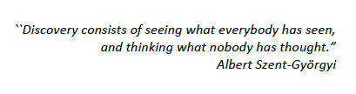


ODE TO ODDERON → OBERON

Slide 25
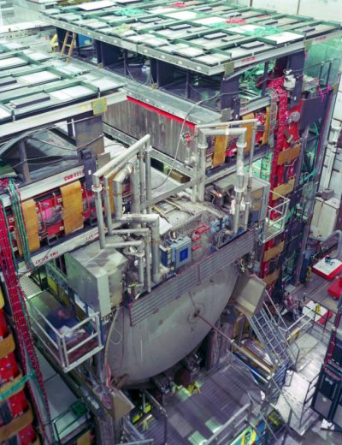
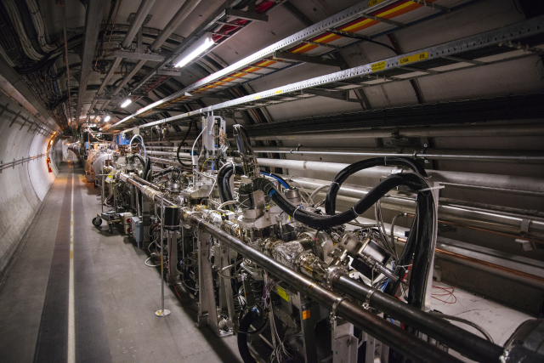
Thank you for your attention!

Slide 26
OBSERVATION OF ODDERON
2020 → 2O2O
THANK YOU FOR YOUR ATTENTION

Slide 27
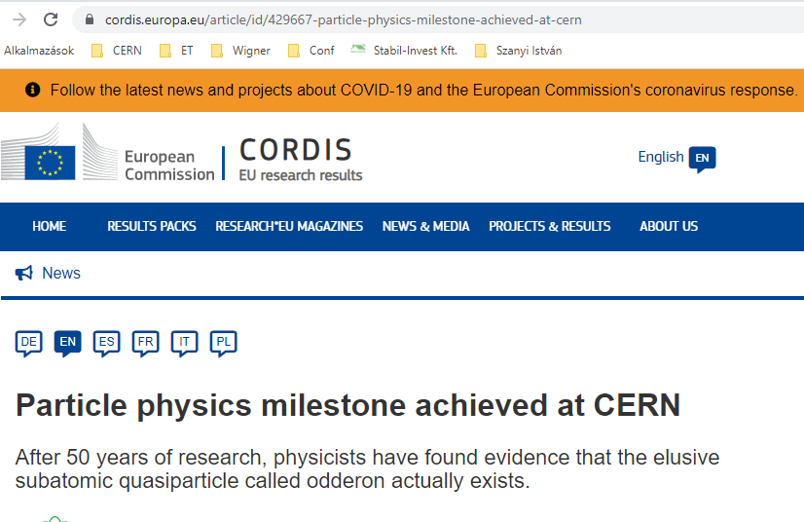
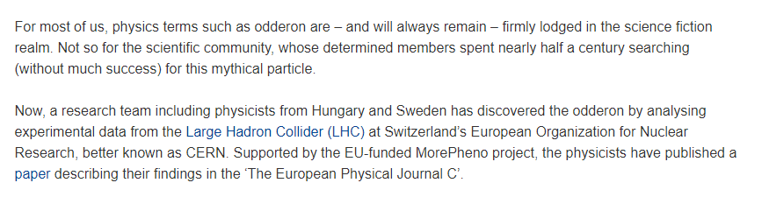
BACKUP SLIDES

Slide 28
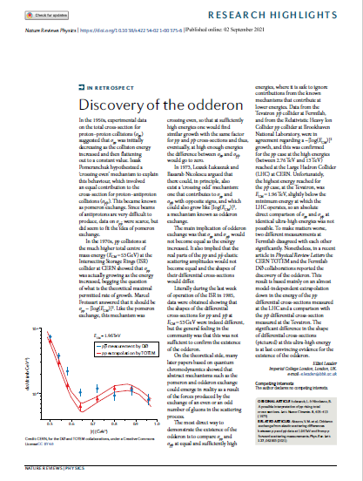
BACKUP SLIDES

Slide 29
Odderon: origin of its name
Odderon name coined in 1975:
D. Joynson, E. Leader, B. Nicolescu, C. Lopez
Nuovo Cim. 30A, 345 (1975)
29

Slide 30
Odderon: well established in QCD
Odderon proposed in Regge phenomenology:
L. Lukaszuk, B. Nicolescu, Lett. Nuovo Cim. 8, 405 (1973)
Three Gluon Integral Equation and Odd c Singlet Regge Singularities in QCD
J. Kwiecinski, M. Praszalowicz, Phys.Lett.B 94 (1980) 413-416
A new Odderon intercept from QCD:
R. A. Janik, J. Wosiek, Phys. Rev. Lett. 82 (1999) 1092
Odderon in QCD:
J. Bartels, L.N. Lipatov, G. P. Vacca: Phys. Lett. B (2000) 178
Odderon in QCD with running coupling:
J. Bartels, C. Contreras, G. P. Vacca, JHEP 04 (2020) 183
For an excellent theory intro/review, see Yu. Kovchegov’s
CTEQ Webinar, April 28, 2021
http://youtu.be/yHBO3zcB3V4
30

Slide 31
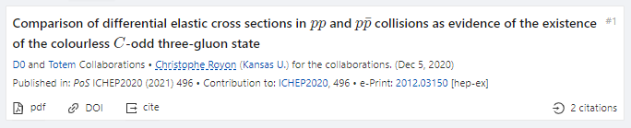
Three Odderon Proceedings with > 5 σ
Gribov’90 Memorial Volume, pp. 69-80 (2021)
https://doi.org/10.1142/9789811238406_0012
EPJ Web Conf. 235 (2020) 06002, proc. ISMD 2019
https://doi.org/10.1051/epjconf/202023506002
31
PoS ICHEP 2020 (2021)
https://doi.org/10.22323/1.390.0496

Slide 32
Formalism in b space
32
Impact parameter or b space:
Elastic scattering interferes with propagation w/o collisions: Genuine quantum physics.
Complex opacity function Ω(s,b) (eikonal, from unitarity)
0 ≤ P(s,b) ≤ 1 : inelastic scattering has a probabilistic interpretation

Slide 33
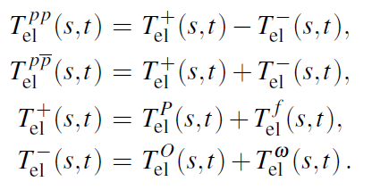
Looking for Crossing-Odd(eron) effects
Three simple consequences:
33
Odderon differential cross-section from pp and ppbar collisions, Reggeized Philips-Barger:
A. Ster, L. Jenkovszky, T. Cs., arxiv:1501.03860, Phys.Rev.D 91 (2015) 7, 074018

Slide 34
Odderon search: strategy with scaling
Known trivial s-dependences in
σ_{tot}(s), σ_{el}(s), B(s), ρ(s)
Try to scale this out
Look for data collapsing (scaling)
Look for scaling violations
In the TeV energy range:
Odderon is equivalent with
a crossing-odd component
Look for violations of C-symmetry
34
Close the energy gap with scaling

Slide 35



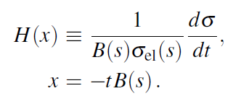
Scaling in the diffractive cone region
Advantages:
1) H(x) = exp(-x) in the cone
2) Start from a place that you know
3) Measurable both for pp and pbarp
35

Slide 36
Test of the H(x) scaling at ISR
36
H(x) = exp(-x) in the cone
Works better than expected, even in the bump/tail region!

Slide 37
A simple derivation of H(x) scaling for all x
Data suggest scaling well beyond the x < 1 cone
Advantages:
H(x) ≠ exp(-x) arbitrary positive def. in the dip-bump region
Measurable both for pp and p-antip. Normalized as H(0) = 1.
More general derivations published, e.g. in the ReBB model
37

Slide 38
Asymmetry parameter for C-violation
A(x|pbarp,s₁|pp,s₂)
does NOT vanish
for a C-symmetry violation AND
A(x|pp,s₁|pp,s₂)
vanishes if
H(x) scaling valid
38
Energy range: HAS to be tested carefully

Slide 39
Main result of A
A(x|pp,s₁|pp,s₂) ~ 0
vanishes if
H(x) scaling valid
A(x|pbarp,s₁|pp,s₂) ≠ 0
does NOT vanish
if Odderon term is present
39
Scaling violations: under theoretical control:
Model calculations by solid line, see e-Print: 2005.14319 [hep-ph]

Slide 40
Is H(x,s) = H(x) at 1.96 TeV?
S IGNAL
MODEL DEPENDENTLY: Yes
1.96 TeV
Highest energy where p+antip data are available
H(x) scaling limit:
in the Bialas-Bzdak model
Fits pbarp data up to largest -t
(red line, dashed line: pp)
Pull plots:
(data-fit)/error
(data-fit)/fit
t_{max}(1.96 TeV, pp) > 1.2 GeV²
→ x_{max}(1.96 TeV, pp) > 20
40

Slide 41
SLIDING WINDOWS
7 TeV data shifted
by ε_{B7,TeV} to minimize χ²
Type A errors are shown only
Both swing and dip regions important!
2020 → 2O2O

Slide 42
Back to Scaling: Model independently
H(x|pp)
s-independent:
2.76 – 7(8) TeV
H(x|pp, 7 TeV)
≠
H(x|pbarp, 1.96)
Odderon,
IF scaling holds
in pp down to
1.96 TeV
6.26 σ
Odderon effect
42
Energy range: tested both model independently and with modelling.
Modelling is useful, but model independent tests more important!

