Slide 1
Real Extended Bialas-Bzdak Model and the Odderon @ 8 TeV
SUPPORTED BY: NKFIH K-133046, ÚNKP-21-3 New National Excellence Program of the Ministry for Innovation and Technology from the source of the National Research, Development and Innovation Fund
based on T. Csörgő, I. Szanyi, Eur. Phys. J. C 81, 611 (2021) and other recent results
T. Csörgő^{1,2}, I. Szanyi^{1,2,3}
¹Wigner RCP, Budapest, Hungary ²MATE KRC, Gyöngyös, Hungary
³ELTE, Budapest, Hungary
Seminar „Białasówka”
1 April 2022, Cracow, Poland

Slide 2
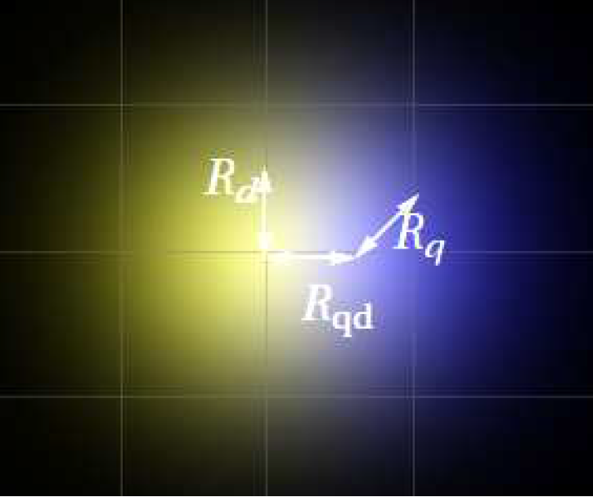
Bialas-Bzdak p=(q,d) model
$${\tilde{σ}}_{in}\left(\vec{b}\right)=\int_{−∞}^{+∞}{…}\int_{−∞}^{+∞}{d^{2}{\vec{s}}_{q}d^{2}{\vec{s}}_{q}^{′}{d^{2}\vec{s}}_{d}d^{2}{\vec{s}}_{d}^{′} D\left({\vec{s}}_{q}, {\vec{s}}_{d}\right) D\left({\vec{s}}_{q}^{′},{\vec{s}}_{d}^{′}\right) σ({\vec{s}}_{q}, {\vec{s}}_{d};{\vec{s}}_{q}^{′},{\vec{s}}_{d}^{′};\vec{b})}$$
quark-diquark distribution inside the proton:
interaction probability of the constituents:
inelastic cross-sections of quark, diquark scatterings :
free parameters:
$${\vec{s}}_{d}=−λ{\vec{s}}_{q}$$
A. Bialas, A. Bzdak Acta Phys.Polon. B 38, 159-168 (2007)
$$D\left({\vec{s}}_{q}, {\vec{s}}_{d}\right)=\frac{1+λ^{2}}{R_{qd}^{2}π}e^{−\frac{s_{q}^{2}+s_{d}^{2}}{R_{qd}^{2}}}δ^{2}({\vec{s}}_{q}+λ{\vec{s}}_{d})$$
$$λ=\frac{m_{q}}{m_{d}}$$
$${\vec{s}}_{d}^{′}=−{λ\vec{s}}_{q}^{′}$$
$$σ\left({\vec{s}}_{q}, {\vec{s}}_{d};{\vec{s}}_{q}^{′},{\vec{s}}_{d}^{′};\vec{b}\right)=1−\prod_{a}{\prod_{b}{\left[1−σ_{ab}(\vec{b}+{\vec{s}}_{a}^{′}−{\vec{s}}_{b})\right]}}$$
$$σ_{ab}\left(\vec{s}\right)=A_{ab}e^{−{|\vec{s}|}^{2}/S_{ab}^{2}}$$
$$S_{ab}^{2}=R_{a}^{2}+R_{b}^{2}$$
$$a\text{, }\text{b} \text{∈} \text{\{}\text{q}\text{,}\text{d}\text{\}}$$
$$σ_{ab,in}=\int_{−∞}^{+∞}{\int_{−∞}^{+∞}{σ_{ab}\left(\vec{s}\right)}}d^{2}\vec{s}$$
$$σ_{qq,in} :{ σ}_{qd,in} :σ_{dd,in}=1 :2 :4$$
Proton-(anti)proton scattering in the quark-diquark model (Glauber style calculation).
$$A_{qq},λ,R_{q},{ R}_{d}, R_{qd},$$
$$(A_{qq}=1 and λ=0.5 can be fixed)$$

Slide 3
Unitarily Real Extended Bialas-Bzdak (ReBB) model
elastic scattering amplitude in the impact parameter space:
the opacity function:
elastic scattering amplitude in momentum space:
arXiv:1505.01415
$$t_{el}\left(s,\vec{b}\right)=i\left[1−e^{−Ω(s,\vec{b})}\right]$$
F. Nemes, T. Csörgő, M. Csanád, Int. J. Mod. Phys. A Vol. 30 (2015) 1550076
$ImΩ≠0$as the real part of the amplitude is not negligibly small
$$Ω\left(s,\vec{b}\right)=ReΩ\left(s,\vec{b}\right)+i ImΩ\left(s,\vec{b}\right)$$
$$ReΩ\left(s,\vec{b}\right)=−\frac{1}{2}ln\left[1−{\tilde{σ}}_{in}\left(s,\vec{b}\right)\right]$$
$$ImΩ\left(s,\vec{b}\right)=−α{ \tilde{σ}}_{in}\left(s,\vec{b}\right)$$
NEW FREE PARAMETER
$$T\left(s,t\right)=2π\int_{0}^{∞}{t_{el}\left(s,\left|\vec{b}\right|\right){ J}_{0}\left(\left|\vec{∆}\right|\left|\vec{b}\right|\right)\left|\vec{b}\right|d\left|\vec{b}\right|}$$
$$\left|\vec{∆}\right|≡\sqrt{−t} as \sqrt{s}→∞$$
($t$ is the squared momentum transfer)

Slide 4
Fit method for Odderon search
least squares fitting with:
it takes into account (in $M$ separately measured $t$ ranges):
the $t$-dependent statistical ($a$) and systematic ($b$) errors (both vertical $σ_{k}$ and horizontal $δ_{k}t$) → $ε_{b}$parameters;
the $t$-independent $σ_{c}$ normalization uncertainties → $ε_{c}$ parameters;
the measured total cross-section $d_{σ_{tot}}$ and ratio $d_{ρ_{0}}$ and their total uncertainties ${δσ}_{tot}$ and ${δρ}_{0}$.
$$χ^{2}=\left(\sum_{j=1}^{M}{‍}\left(\sum_{i=1}^{n_{j}}{‍}\frac{{\left(d_{ij}+ε_{bj}{\tilde{σ}}_{bij}+ε_{cj}d_{ij}σ_{cj}−th_{ij}\right)}^{2}}{{\tilde{σ}}_{ij}^{2}}\right)+ε_{bj}^{2}+ε_{cj}^{2}\right)+{\left(\frac{d_{σ_{tot}}−th_{σ_{tot}}}{δσ_{tot}}\right)}^{2}+{\left(\frac{d_{ρ_{0}}−th_{ρ_{0}}}{δρ_{0}}\right)}^{2}$$
$${\tilde{σ}}_{ij}^{2}={\tilde{σ}}_{aij}\left(\frac{d_{ij}+ε_{bj}{\tilde{σ}}_{bij}+ε_{cj}d_{ij}σ_{cj}}{d_{ij}}\right)$$
$${\tilde{σ}}_{kij}=\sqrt{σ_{kij}^{2}+(d_{ij}^{′}{δ_{k}t}_{ij})^{2}}, k∈\{a,b\}$$
A. Adare et al. (PHENIX Collab.)
Phys. Rev. C 77, 064907
minimization with CERN Root MINUIT, parameter error estimation by MINOS.

Slide 5
Fit method for Odderon search
least squares fitting with:
it takes into account (in $M$ separately measured $t$ ranges):
the $t$-dependent statistical ($a$) and systematic ($b$) errors (both vertical $σ_{k}$ and horizontal $δ_{k}t$) → $ε_{b}$parameters;
the $t$-independent $σ_{c}$ normalization uncertainties → $ε_{c}$ parameters;
the measured total cross-section $d_{σ_{tot}}$ and ratio $d_{ρ_{0}}$ and their total uncertainties ${δσ}_{tot}$ and ${δρ}_{0}$.
$$χ^{2}=\left(\sum_{j=1}^{M}{‍}\left(\sum_{i=1}^{n_{j}}{‍}\frac{{\left(d_{ij}+ε_{bj}{\tilde{σ}}_{bij}+ε_{cj}d_{ij}σ_{cj}−th_{ij}\right)}^{2}}{{\tilde{σ}}_{ij}^{2}}\right)+ε_{bj}^{2}+ε_{cj}^{2}\right)+{\left(\frac{d_{σ_{tot}}−th_{σ_{tot}}}{δσ_{tot}}\right)}^{2}+{\left(\frac{d_{ρ_{0}}−th_{ρ_{0}}}{δρ_{0}}\right)}^{2}$$
$${\tilde{σ}}_{ij}^{2}={\tilde{σ}}_{aij}\left(\frac{d_{ij}+ε_{bj}{\tilde{σ}}_{bij}+ε_{cj}d_{ij}σ_{cj}}{d_{ij}}\right)$$
$${\tilde{σ}}_{kij}=\sqrt{σ_{kij}^{2}+(d_{ij}^{′}{δ_{k}t}_{ij})^{2}}, k∈\{a,b\}$$
A. Adare et al. (PHENIX Collab.)
Phys. Rev. C 77, 064907
The $χ^{2}$ parameters $ε_{i}$ were considered as fit parameters in
T. Csörgő, I. Szanyi, Eur. Phys. J. C 81, 611 (2021) decreasing NDF.
minimization with CERN Root MINUIT, parameter error estimation by MINOS.

Slide 6
Fit method for Odderon search
least squares fitting with:
it takes into account (in $M$ separately measured $t$ ranges):
the $t$-dependent statistical ($a$) and systematic ($b$) errors (both vertical $σ_{k}$ and horizontal $δ_{k}t$) → $ε_{b}$parameters;
the $t$-independent $σ_{c}$ normalization uncertainties → $ε_{c}$ parameters;
the measured total cross-section $d_{σ_{tot}}$ and ratio $d_{ρ_{0}}$ and their total uncertainties ${δσ}_{tot}$ and ${δρ}_{0}$.
$$χ^{2}=\left(\sum_{j=1}^{M}{‍}\left(\sum_{i=1}^{n_{j}}{‍}\frac{{\left(d_{ij}+ε_{bj}{\tilde{σ}}_{bij}+ε_{cj}d_{ij}σ_{cj}−th_{ij}\right)}^{2}}{{\tilde{σ}}_{ij}^{2}}\right)+ε_{bj}^{2}+ε_{cj}^{2}\right)+{\left(\frac{d_{σ_{tot}}−th_{σ_{tot}}}{δσ_{tot}}\right)}^{2}+{\left(\frac{d_{ρ_{0}}−th_{ρ_{0}}}{δρ_{0}}\right)}^{2}$$
$${\tilde{σ}}_{ij}^{2}={\tilde{σ}}_{aij}\left(\frac{d_{ij}+ε_{bj}{\tilde{σ}}_{bij}+ε_{cj}d_{ij}σ_{cj}}{d_{ij}}\right)$$
$${\tilde{σ}}_{kij}=\sqrt{σ_{kij}^{2}+(d_{ij}^{′}{δ_{k}t}_{ij})^{2}}, k∈\{a,b\}$$
A. Adare et al. (PHENIX Collab.)
Phys. Rev. C 77, 064907
The $χ^{2}$ parameters $ε_{i}$ were considered as fit parameters in
T. Csörgő, I. Szanyi, Eur. Phys. J. C 81, 611 (2021) decreasing NDF.
$ε_{i}$-s, in fact, must be considered as both measurements and fit parameters
not effecting the NDF. This is done now.
minimization with CERN Root MINUIT, parameter error estimation by MINOS.

Slide 7
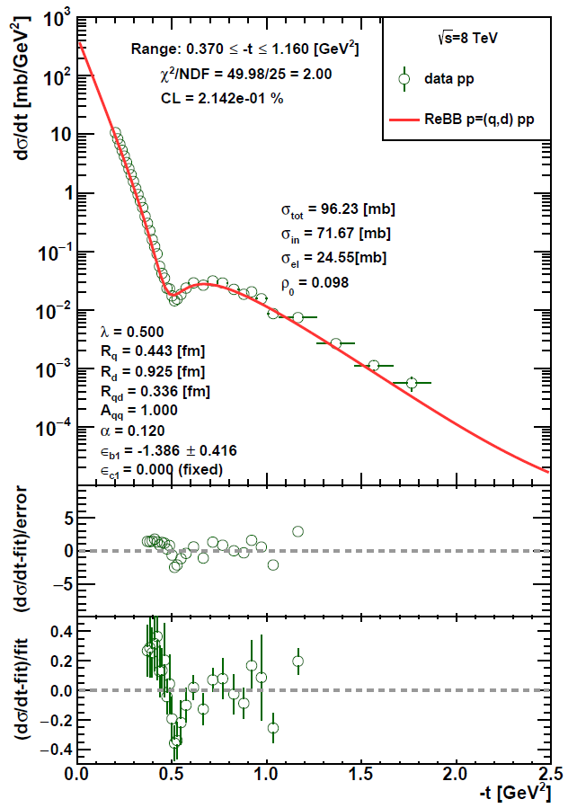
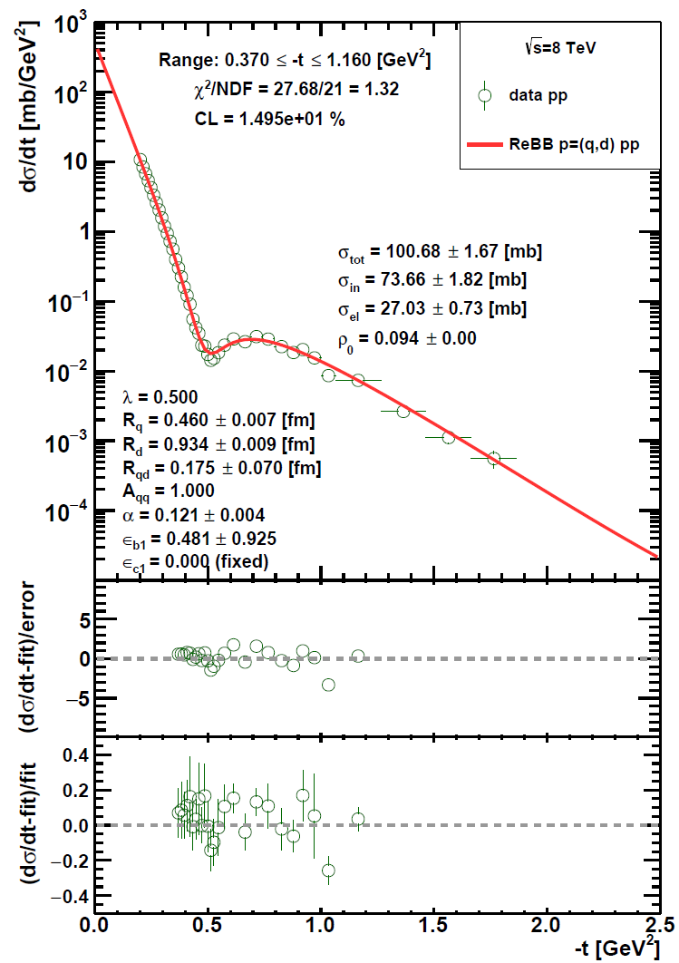
ReBB model @ 8 TeV
with extrapolated
model parameters
with optimized
model parameters
data: TOTEM Collab., Eur. Phys. J. C 82, 263 (2022)

Slide 8
ReBB model @ 8 TeV
with extrapolated
model parameters
with optimized
model parameters
$CL>0.1 \%$ with extrapolated model parameters
$CL≫0.1 \% \text{with} \text{optimized} \text{model} \text{parameters}$
data: TOTEM Collab., Eur. Phys. J. C 82, 263 (2022)

Slide 9
ReBB model @ 8 TeV
with extrapolated
model parameters
with optimized
model parameters
$CL>0.1 \%$ with extrapolated model parameters
$CL≫0.1 \% \text{with} \text{optimized} \text{model} \text{parameters}$
ReBB model gives a statistically acceptable description @ 8 TeV
data: TOTEM Collab., Eur. Phys. J. C 82, 263 (2022)

Slide 10
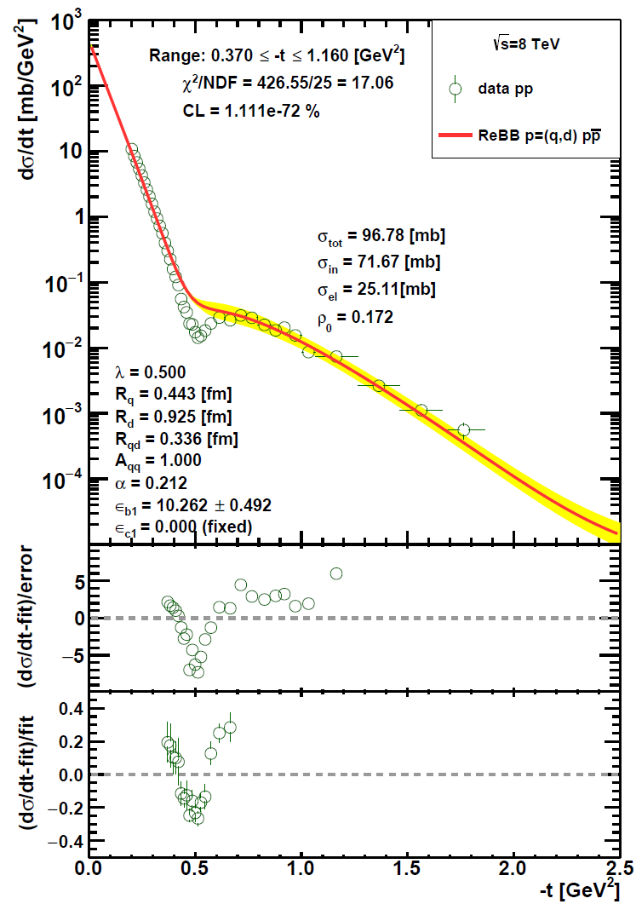
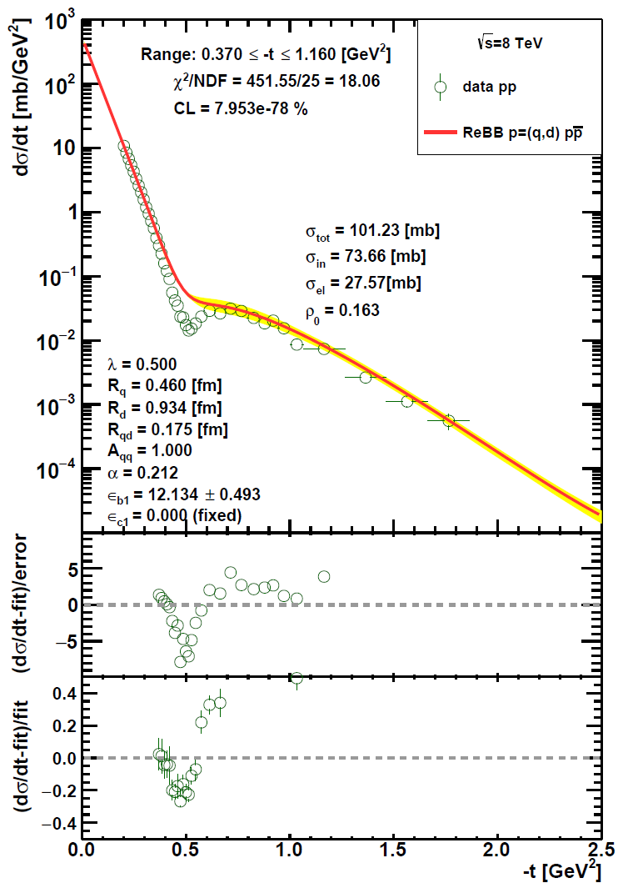
Odderon @ 8 TeV from ReBB model
with extrapolated
model parameters
with $R_{q}, R_{d}, R_{qd}$
parameter values taken from pp data fit
data: TOTEM Collab., Eur. Phys. J. C 82, 263 (2022)

Slide 11
Odderon @ 8 TeV from ReBB model
with extrapolated
model parameters
with $R_{q}, R_{d}, R_{qd}$
parameter values taken from pp data fit
a resulting $CL≤1.111×{10}^{−72} \%$ from the comparison $pp$ data and $p\overline{p}$ ReBB model curve corresponds to an Odderon significance $≥18.28 σ$ @ 8 TeV
data: TOTEM Collab., Eur. Phys. J. C 82, 263 (2022)

Slide 12
Analytical approximation for significance calculation
the Gaussian probability density function with mean $x_{0}$ and and variance $σ^{2}$:
$$ρ(x)=\frac{1}{\sqrt{2πσ^{2}}}e^{−\frac{{\left(x−x_{0}\right)}^{2}}{2σ^{2}}}$$
$$\int_{−∞}^{∞}{dx}ρ\left(x\right)=1$$
$$ρ\left(x;x_{0,}σ\right)$$
the confidence level corresponding to $nσ$significance:
$$CL=2\int_{x_{0}+nσ}^{∞}{dx}ρ\left(x\right)$$
$$−nσ$$
-$σ$
$$x_{0}$$
$$σ$$
$$nσ$$
applying a variable change, ${x→x}^{′}=x−(x_{0}+nσ)$:
$$CL=\sqrt{\frac{2}{πσ^{2}}}\int_{0}^{∞}{dx′}e^{−\frac{{\left(x^{′}+nσ\right)}^{2}}{2σ^{2}}}=\sqrt{\frac{2}{πσ^{2}}}e^{−\frac{n}{2}}\int_{0}^{∞}{dx′}e^{−\frac{x^{′2}+2x^{′}nσ}{2σ^{2}}}≤\sqrt{\frac{2}{πσ^{2}}}e^{−\frac{n^{2}}{2}}\int_{0}^{∞}{dx′}e^{−\frac{x^{′}n}{σ}}$$
$$CL≤\sqrt{\frac{2}{πn^{2}}}e^{−\frac{n}{2}}$$
this formula gives the lower limit for the significance $n$ in $σ$-s corresponding to a $CL$ value

Slide 13
Odderon observation within the ReBB model analysis
combination of significances by summing the individual $χ^{2}$ and $NDF$ values:
combination of significances $s_{i}$ by Stouffner method:
$$χ^{2}=\sum_{i}{χ_{i}^{2}}$$
$$NDF=\sum_{i}{NDF_{i}}$$
$$s=\frac{\sum_{i=1}^{N}{s_{i}}}{\sqrt{N}}$$

Slide 14
Odderon observation within the ReBB model analysis
At least $6. 80 σ$ (or $6. 31 σ$ by Stouffner method) combined Odderon signal from the data-model comparison at the two lowest energies.
combination of significances by summing the individual $χ^{2}$ and $NDF$ values:
combination of significances $s_{i}$ by Stouffner method:
$$χ^{2}=\sum_{i}{χ_{i}^{2}}$$
$$NDF=\sum_{i}{NDF_{i}}$$
$$s=\frac{\sum_{i=1}^{N}{s_{i}}}{\sqrt{N}}$$

Slide 15
Odderon observation within the ReBB model analysis
At least $6. 80 σ$ (or $6. 31 σ$ by Stouffner method) combined Odderon signal from the data-model comparison at the two lowest energies.
$>37. 75 σ$ (or $>32. 48 σ$ by Stouffner method) combined Odderon signal from the data-model comparison at all the four energies.
combination of significances by summing the individual $χ^{2}$ and $NDF$ values:
combination of significances $s_{i}$ by Stouffner method:
$$χ^{2}=\sum_{i}{χ_{i}^{2}}$$
$$NDF=\sum_{i}{NDF_{i}}$$
$$s=\frac{\sum_{i=1}^{N}{s_{i}}}{\sqrt{N}}$$

Slide 16
H(x) scaling of the ReBB model
the H(x) scaling is present in the energy range $\sqrt{s_{1}}≤\sqrt{s} ≤\sqrt{s_{2}}$ if the
scaling function is energy independent in that range i.e. $H\left(x,s_{1}\right)=H\left(x,s_{2}\right)$.
$$H\left(x,s\right)={\left.\frac{1}{B_{0}\left(s\right)σ_{el}\left(s\right)}\frac{dσ_{el}}{dt}\right|}_{x=−{tB}_{0}\left(s\right)}$$
T. Csörgő, T. Novák, R. Pasechnik, A. Ster, and I. Szanyi, Eur. Phys. J. C 81, 180 (2021)
conditions for ReBB model H(x) scaling to be present:
energy independence for the $α$ parameter (or $ρ_{0}$)
the energy dependence of the scale parameters is determined by the same factorizable $b(s)$ scaling function
(or since $α\sim ρ_{0})$
$$α\left(s\right)=α\left(s_{0}\right)$$
$$ρ_{0}\left(s\right)=ρ_{0}\left(s_{0}\right)$$
$$R_{q}\left(s\right)=b\left(s\right)R_{q}(s_{0})$$
$$R_{d}\left(s\right)=b\left(s\right)R_{d}(s_{0})$$
$$R_{qd}\left(s\right)=b\left(s\right)R_{qd}(s_{0})$$
($\sqrt{s_{0}}$ is a reference energy to be chosen)

Slide 17
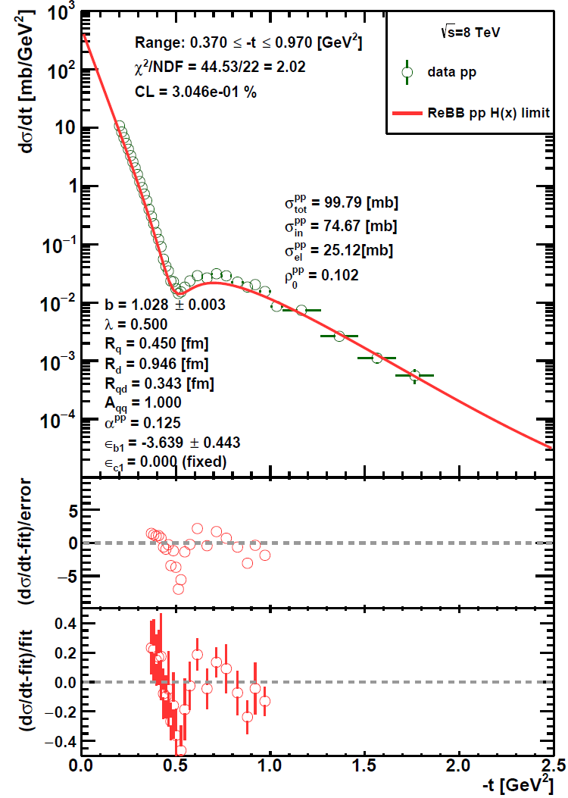
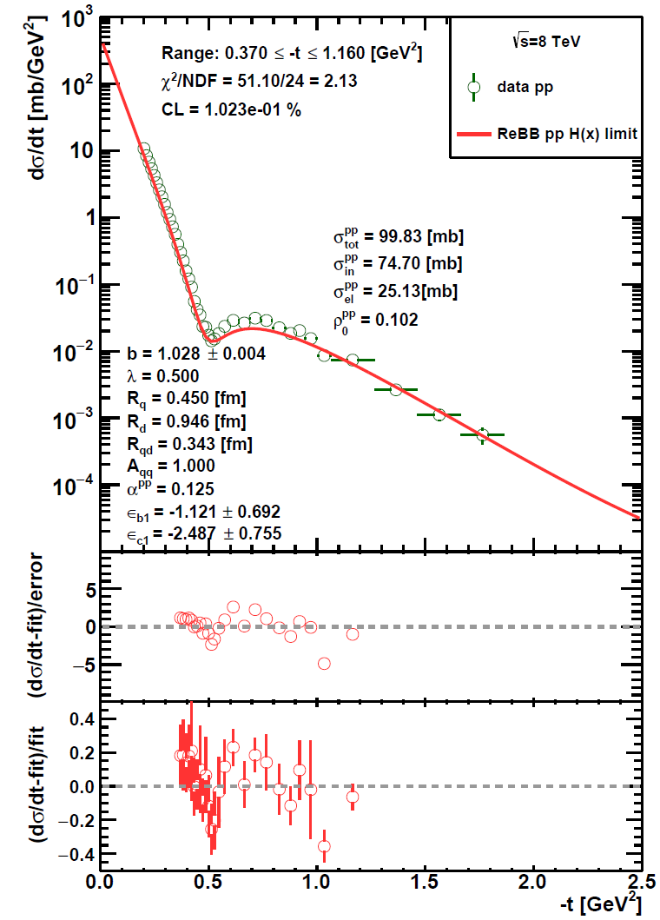
ReBB H(x) model @ 8 TeV
assuming 4 % normalization uncertainty
data: TOTEM Collab., Eur. Phys. J. C 82, 263 (2022)

Slide 18
ReBB H(x) model @ 8 TeV
assuming 4 % normalization uncertainty
ReBB H(x) description is acceptable in a more limited range, $0.37 ≤−t ≤0.97$ GeV²
data: TOTEM Collab., Eur. Phys. J. C 82, 263 (2022)

Slide 19
ReBB H(x) model @ 8 TeV
assuming 4 % normalization uncertainty
if a 4.5% normalisation uncertainty is assumed, the ReBB H(x) description is acceptable in the validity range of the ReBB model,
$0.37 ≤−t ≤1.2$ GeV²
ReBB H(x) description is acceptable in a more limited range, $0.37 ≤−t ≤0.97$ GeV²
data: TOTEM Collab., Eur. Phys. J. C 82, 263 (2022)

Slide 20
Summary
the ReBB model gives satisfactory description for available $pp$ and $p\overline{p}$ data in the kinematical ranges $0.546 ≤\sqrt{s} ≤8$ TeV and $0.37 ≤−t ≤1.2$ GeV²
comparative study of $pp$ and $p\overline{p}$ differential cross sections by extrapolations to the same kinematical regions
model-dependent evidence for Odderon exchange in t-channel at $\sqrt{s}≳1 TeV$ with a significance of at least 6.80σ (or 6.31σ by Stouffner method)
the ReBB model manifests H(x) scaling if the parameters $R_{q}$, $R_{d}$, and $R_{qd}$ have the same factorizable energy dependence and the parameter $α$ is energy independent
the ReBB H(x) model gives a statistically acceptable description for the 8 TeV pp data but in a narrower range than the validity range of the ReBB model if a 4.5% normalistion error is not assumed

Slide 21
Thank you for your attention!

Slide 22
Backup slides

Slide 23
Measurable quantities
differential cross section:
total, elastic and inelastic cross sections:
ratio ρ₀:
$$\frac{dσ}{dt}\left(s,t\right)=\frac{1}{4π}{\left|T\left(s,t\right)\right|}^{2}$$
$$σ_{el}\left(s\right)=\int_{−∞}^{0}{\frac{dσ(s,t)}{dt}dt}$$
$${ σ}_{tot}\left(s\right)=2ImT\left(s,t=0\right)$$
$$σ_{in}\left(s\right)={ σ}_{tot}\left(s\right) {− σ}_{el}\left(s\right)$$
slope of dσ/dt:
$$B\left(s,t\right)=\frac{d}{dt}\left(ln\frac{dσ}{dt}(s,t)\right)$$
$$ρ_{0}\left(s\right)=\lim_{t→0}{ρ(s,t)}≡\frac{ReT\left(s,t→0\right)}{ImT\left(s,t→0\right)}$$
$$B_{0}\left(s\right)=\lim_{t→0}{B\left(s,t\right)}$$

Slide 24
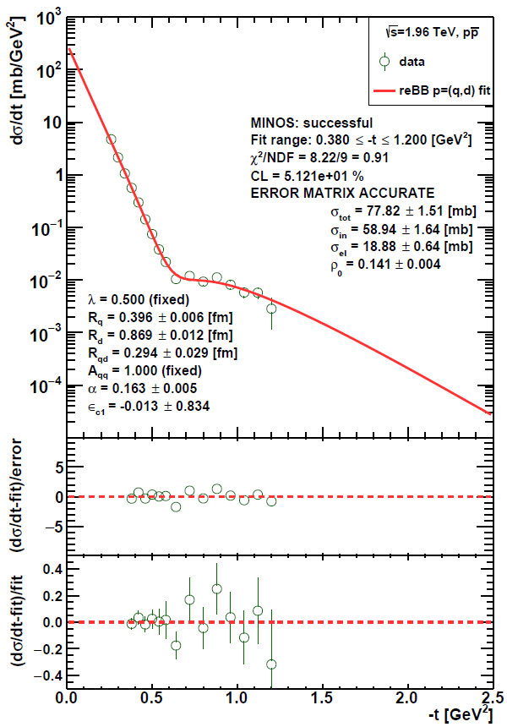
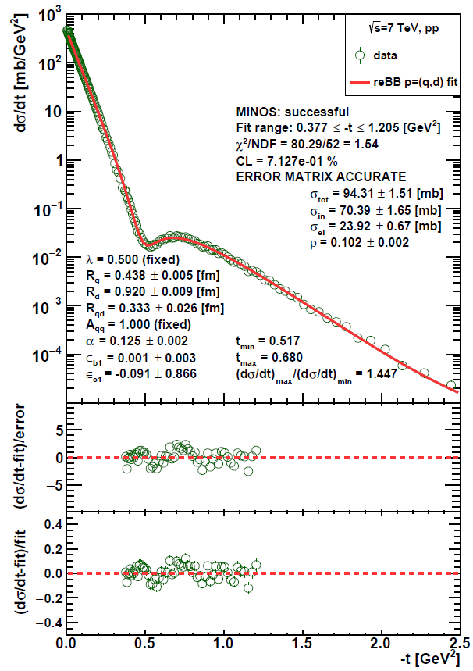
ReBB model analysis of $pp$ and $p\overline{p}$ data
→ fits for $pp$ dσ/dt data at 2.76 TeV and 7 TeV and for $p\overline{p}$ dσ/dt data at 0.546 TeV and 1.96 TeV
→ use of the $χ^{2}$ definition developed by PHENIX
→ determination of the energy dependences of the model parameters
→ satisfactory description in the kine-matical range: $0.546 ≤\sqrt{s} ≤7$ TeV &$0.37 ≤−t ≤1.2$ GeV²
→ observation of an at least 7.08σ Odderon signal
Examples of ReBB model fits for $pp$ and $p\overline{p}$ differential cross section data.
T. Csörgő, I. Szanyi, Eur. Phys. J. C 81, 611 (2021)

Slide 25
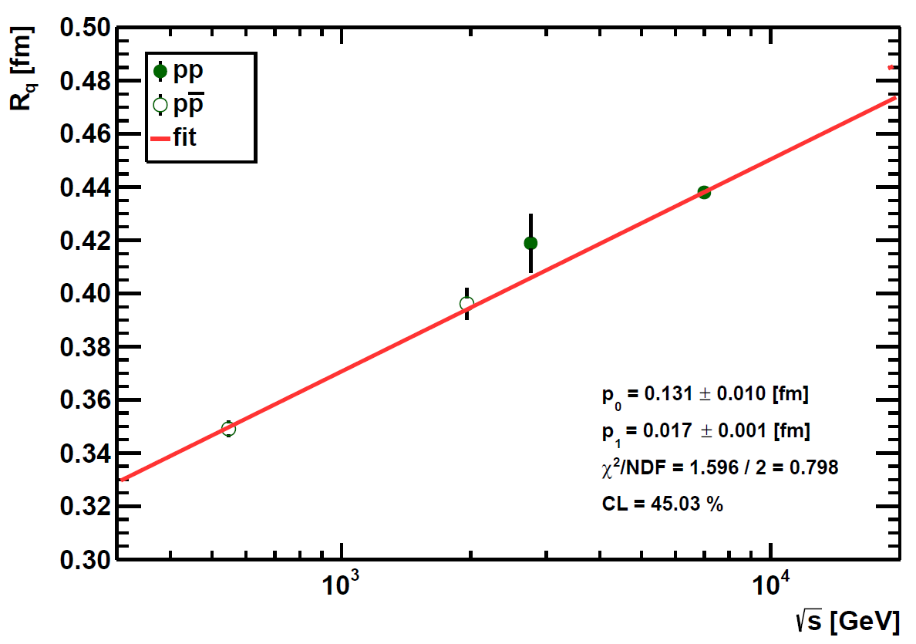
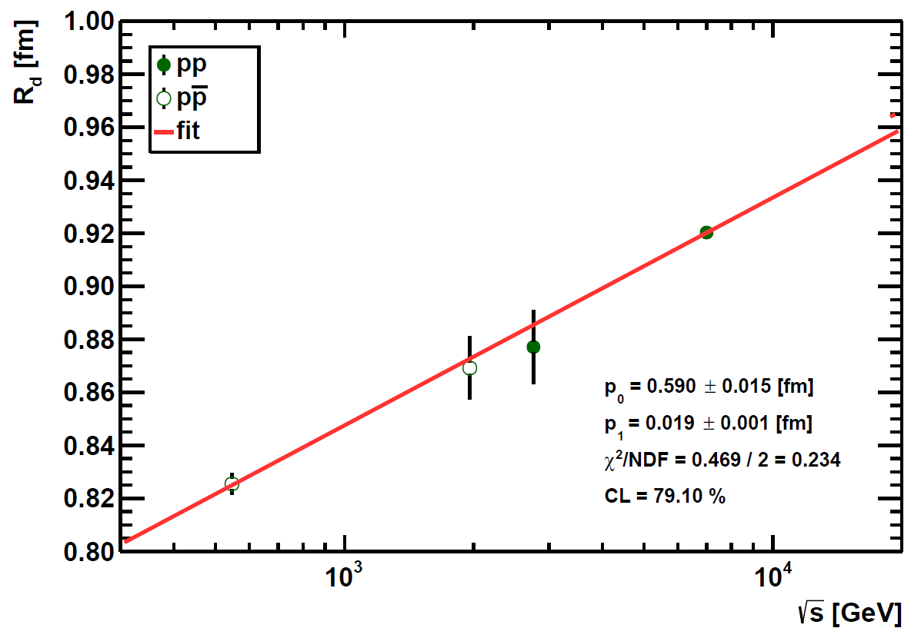
Energy dependences of the model parameters
$$R_{q}\left(s\right)=p_{0}+p_{1}ln⁡(s)$$
$$R_{d}\left(s\right)=p_{0}+p_{1}ln⁡(s)$$
The energy dependences of the scale parameters, $R_{q}(s)$, $R_{d}(s)$, and $R_{qd}\left(s\right)$ are linear logarithmic and the same for $pp$ and $p\overline{p}$ processes!
The energy dependence of the $α$ parameter, $α(s)$ is linear logarithmic too, but not the same for $pp$ and $p\overline{p}$ processes!

Slide 26
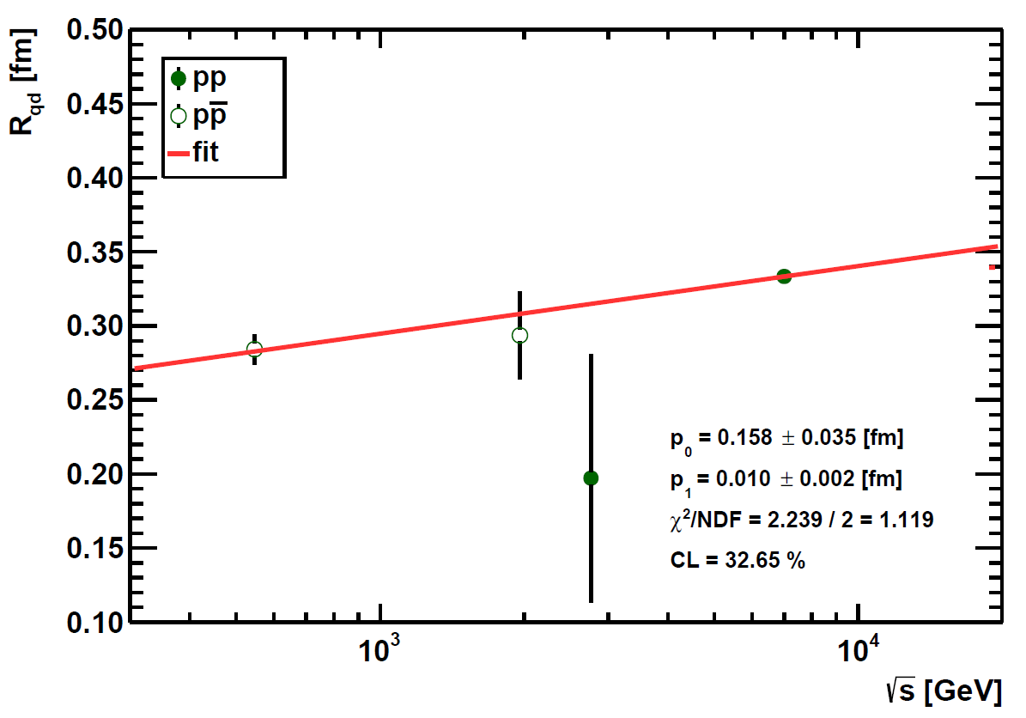
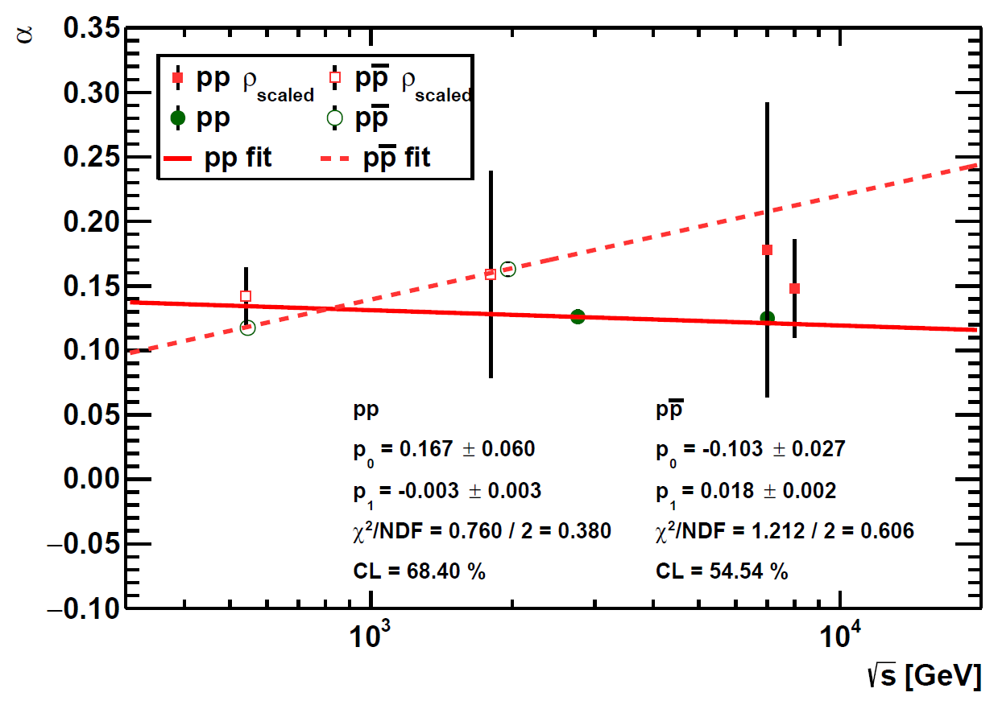
Energy dependences of the model parameters
$$R_{qd}\left(s\right)=p_{0}+p_{1}ln⁡(s)$$
$$α\left(s\right)=p_{0}+p_{1}ln⁡(s)$$
The energy dependences of the scale parameters, $R_{q}(s)$, $R_{d}(s)$, and $R_{qd}\left(s\right)$ are linear logarithmic and the same for $pp$ and $p\overline{p}$ processes!
The energy dependence of the $α$ parameter, $α(s)$ is linear logarithmic too, but not the same for $pp$ and $p\overline{p}$ processes!

Slide 27
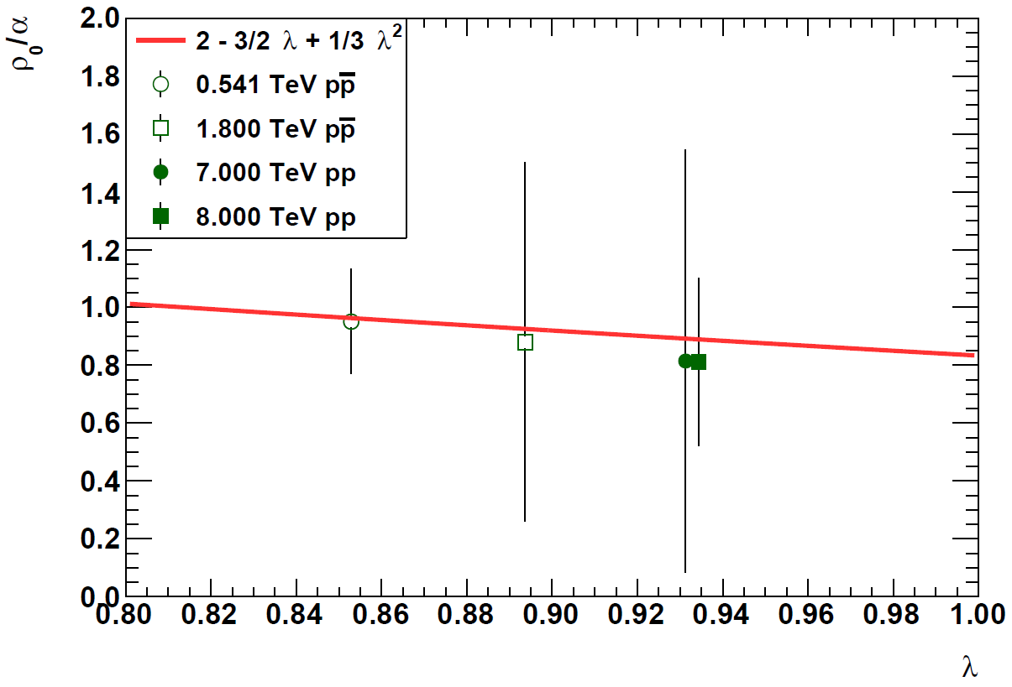
Proportionality between $ρ_{0}\left(s\right)$ and $α(s)$
$$t_{el}(s,b)=i\left(1−e^{\left.i α {\tilde{σ}}_{in}(s,b\right)}\sqrt{\left.1−{\tilde{σ}}_{in}(s,b\right)}\right)$$
$$α{\tilde{σ}}_{in}≪1$$
$$Im t_{el}\left(s,b\right)≃λ\left(s\right)exp\left(−\frac{b^{2}}{\left.2R^{2}(s\right)}\right)$$
$$ρ_{0}(s)=α(s) \left(2−\frac{3}{2}λ\left(s\right)+\frac{1}{3}λ^{2}\left(s\right)\right)$$
$$λ(s)=Im t_{el}\left(s,b=0\right)$$
The dependence of $ρ_{0}/α$ on $λ=Im t_{el}\left(s,b=0\right)$ in the TeV energy range. The data points are generated numerically by using the trends of the ReBB model scale parameters and the experimentally measured $ρ$-parameter values.
→ by rescaling one can get additional $α$ parameter values at energies where $ρ_{0}$ is measured (and vice versa)

